Slide 1
Fundamentals of Remote Sensing
SNAP Tutorial.
Oil spills detection in SAR images

Slide 2
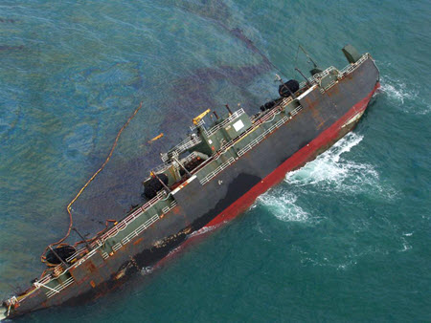
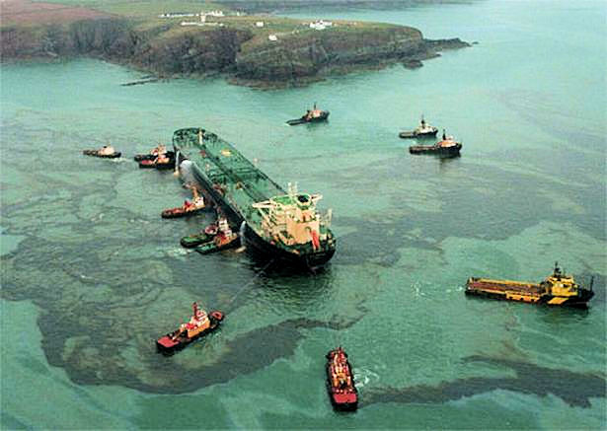
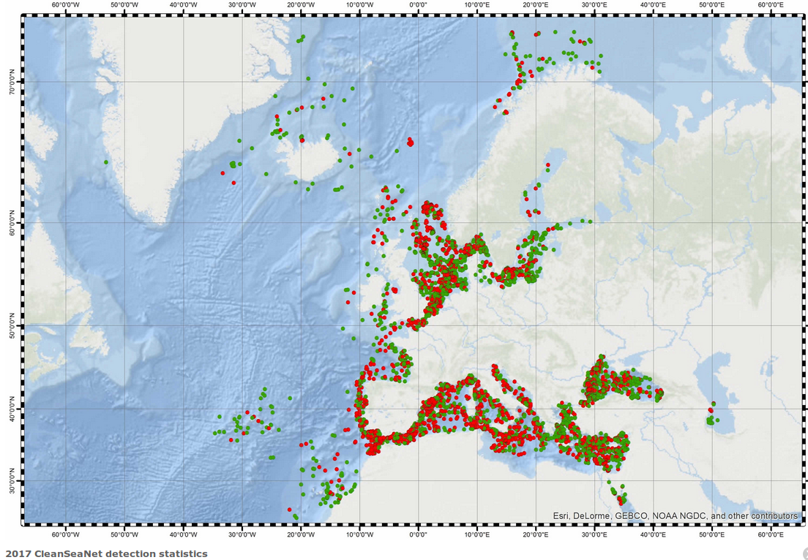
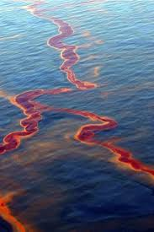
Oil spills

Slide 3

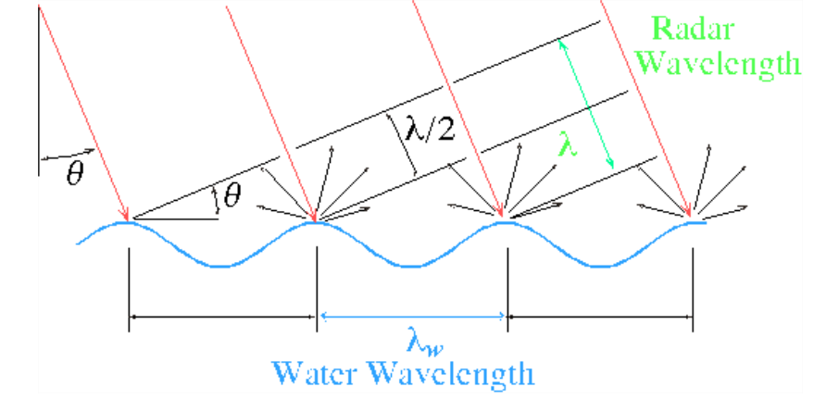
Radar backscattering
Bragg scattering from wave surface

Slide 4
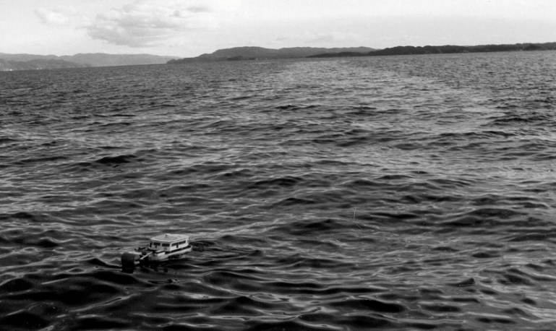
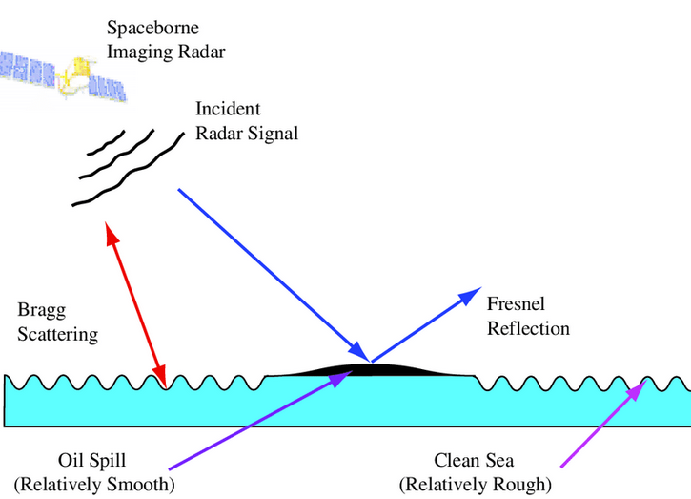

Oil spill backscatter
The main mechanism in detection of oil slicks is the dampening effect of oil on water. Dampening of sea waves results in reduced radar return from the affected area, so that oil slicks appear as relatively dark features on
the SAR scenes

Slide 5
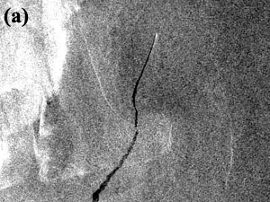
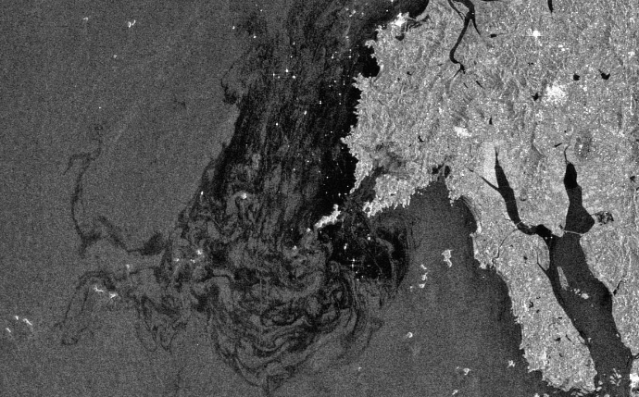
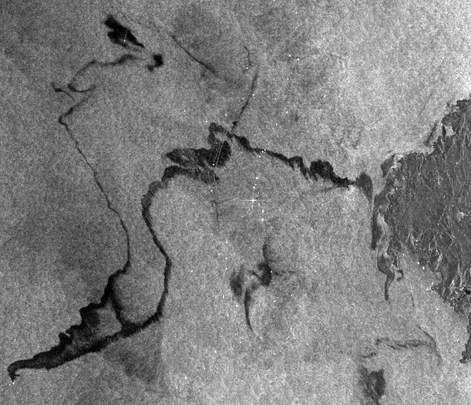
Oil spils in SAR image

Slide 6
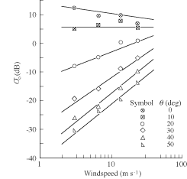
Radar BS crossection

Slide 7
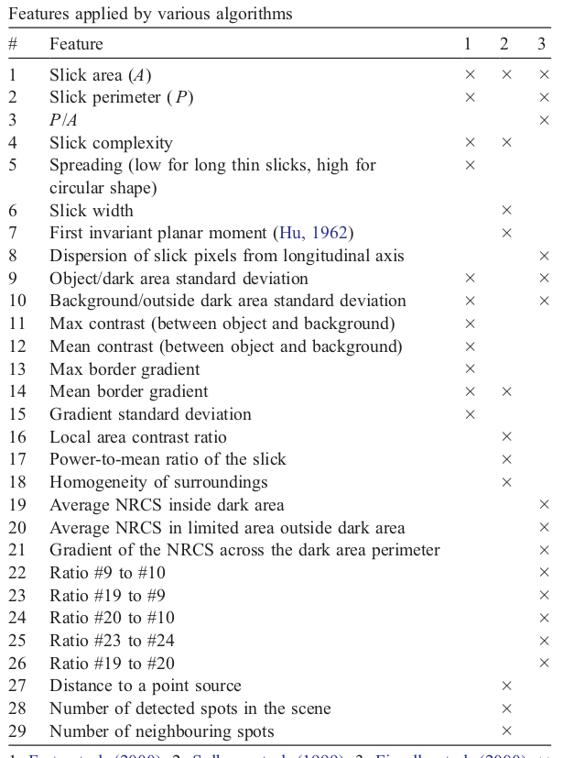

Slide 8
